Slide 1

CPBPB&T2024
R you ready fa dis
December 5, 2024
Light Hall 306A/B
Nashville, Tennessee
http://tiny.cc/cpbpbandt2024
#CPBPB&T2024

Slide 2

Erika Cao
Tonnar
Castellano
Aleksya
Drobshoff
Ethan Durham
SPEAKERS
James
Evans
Katie Jo
Gelasco
Porcia
Haynes
Liane
Lee
Morad
Malek
Kole
Martin
Jessica
Myat
Ellie
Pingry
Alexis Roberson
Paige
Schiebel
Salimat
Sofela

Slide 3
Nutrition of Fast-Food Restaurants
Erika Weizhi Cao

Slide 4
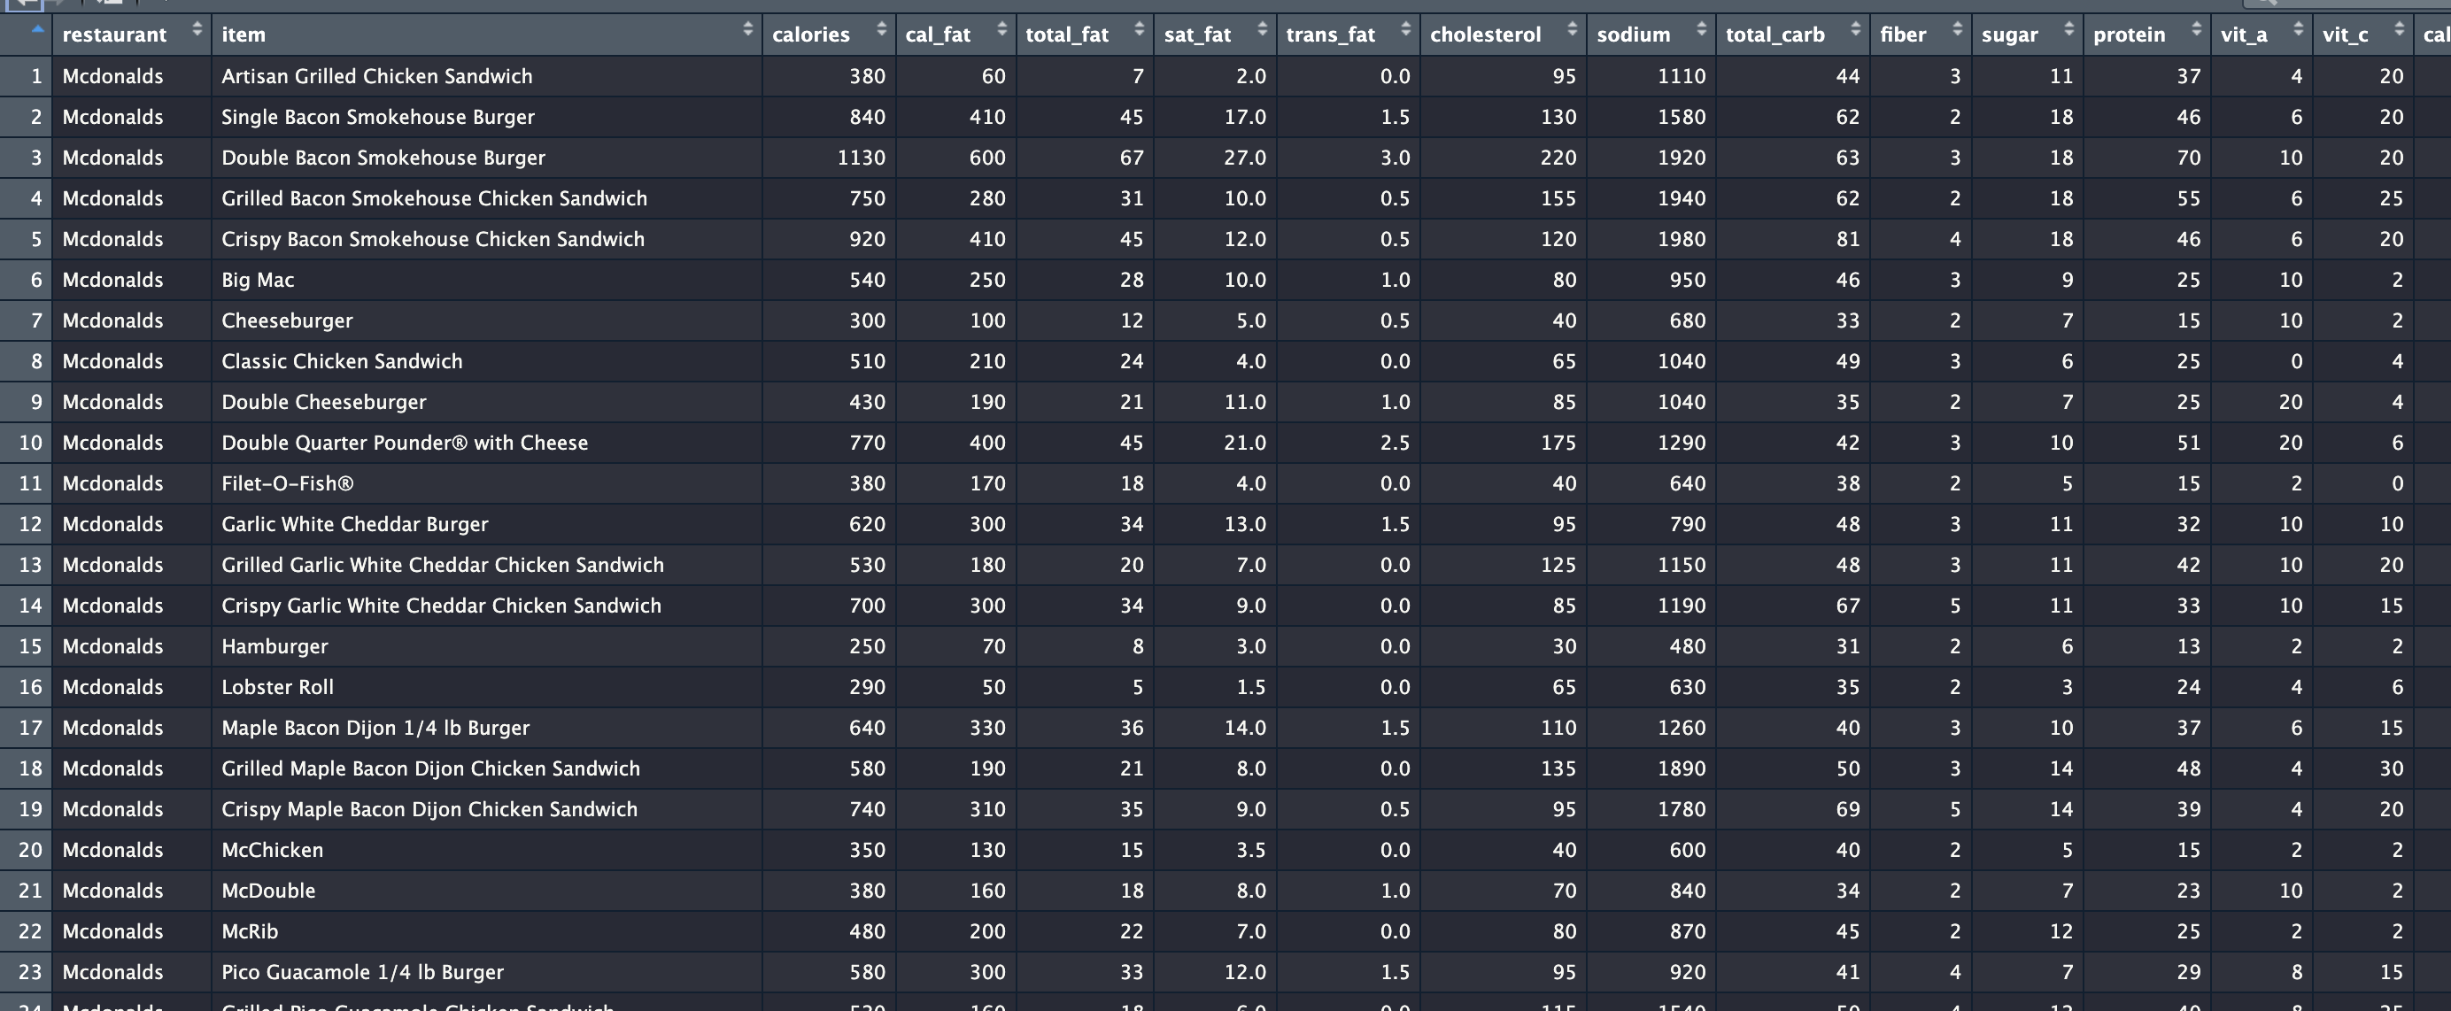
Overview of the Table

Slide 5
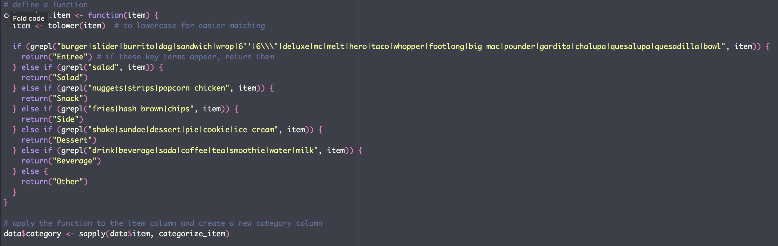
FlowChart
Data Cleaning
Finding Duplicates, Assigning Categories

Slide 6
FlowChart
Data Cleaning
Finding Duplicates, Assigning Categories
Distribution Plots and Tables

Slide 7
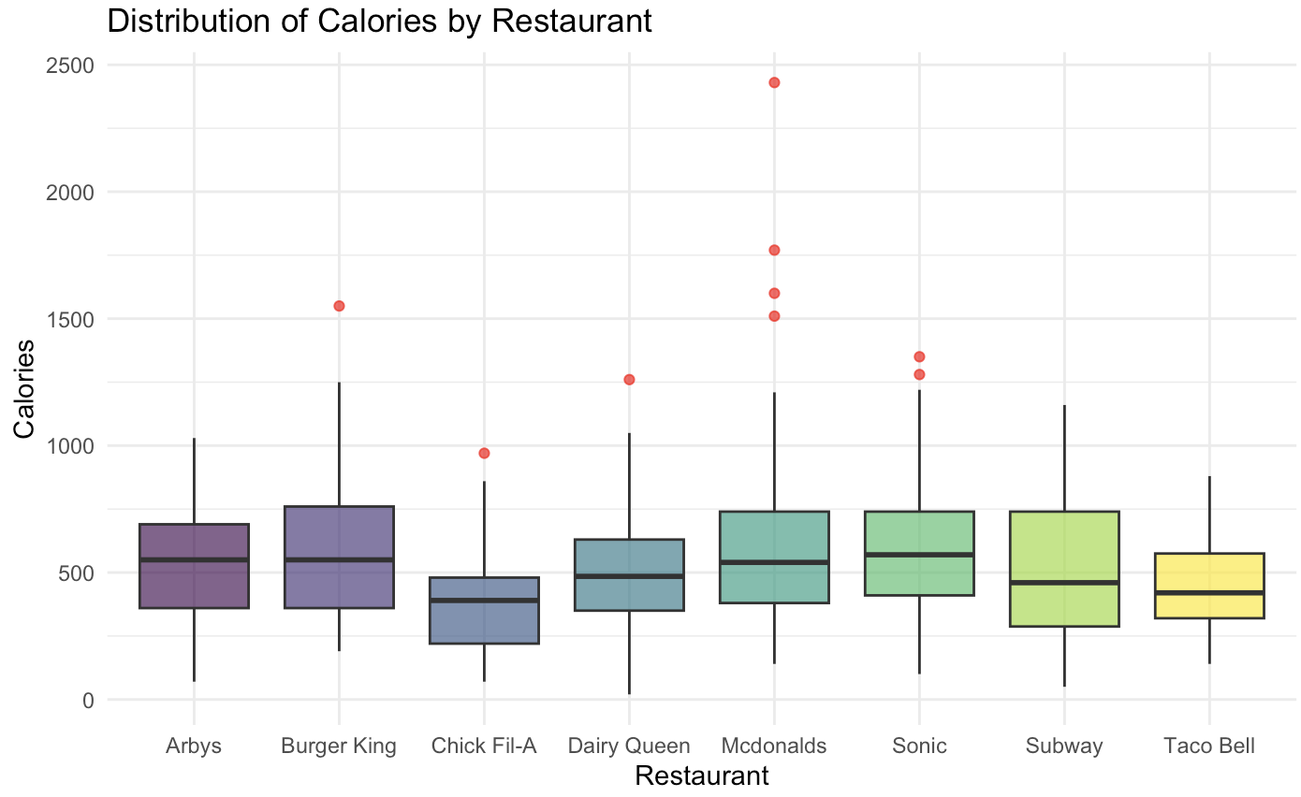
Distribution of Calories by Restaurant

Slide 8
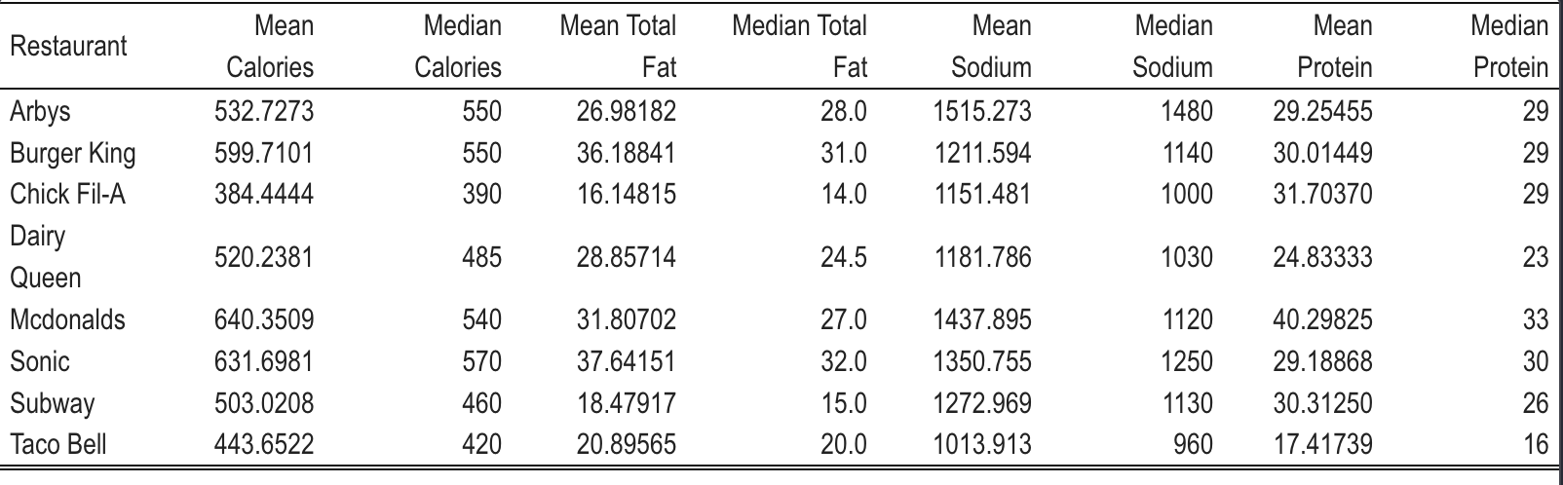
Nutrition Parameters by Restaurant
Can we determine which restaurant is healthier than the other by looking at these parameters?

Slide 9
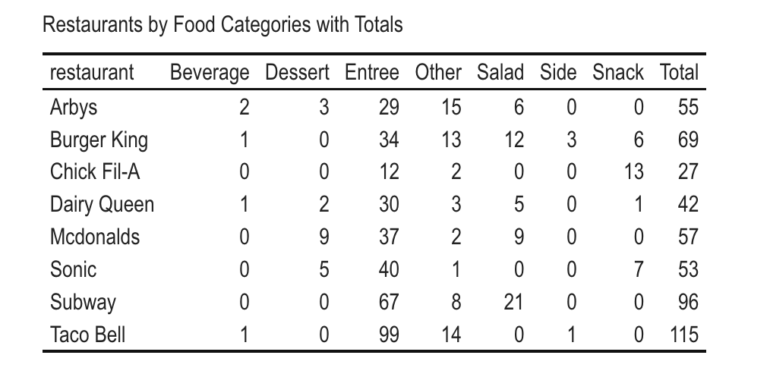
Restaurants by Food Categories

Slide 10
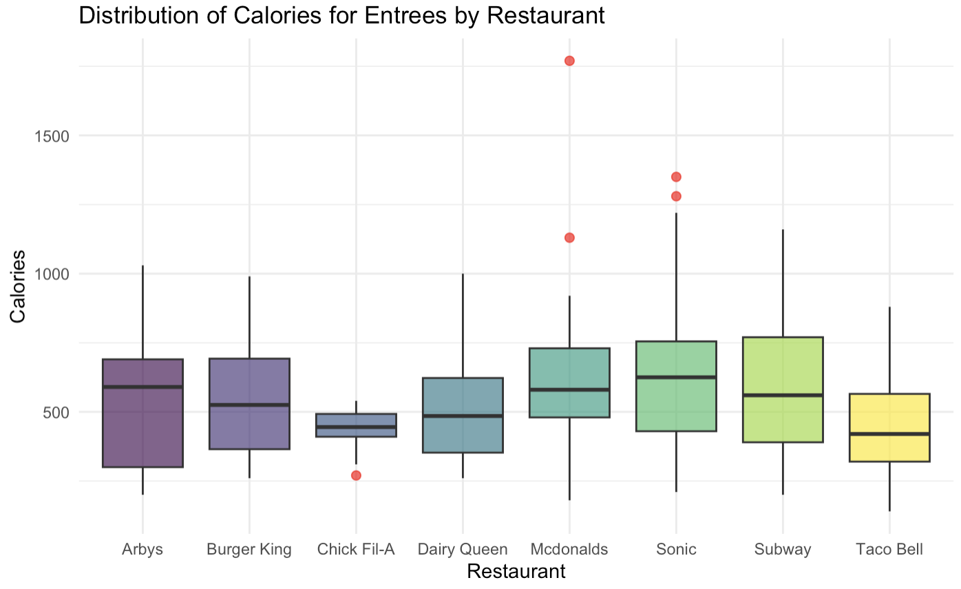
Distribution of Calories for Entrees by Restaurant

Slide 11
FlowChart
Data Cleaning
Finding Duplicates, Assigning Categories
Distribution Plots and Tables
Correlation Plots and Statistical Tests

Slide 12
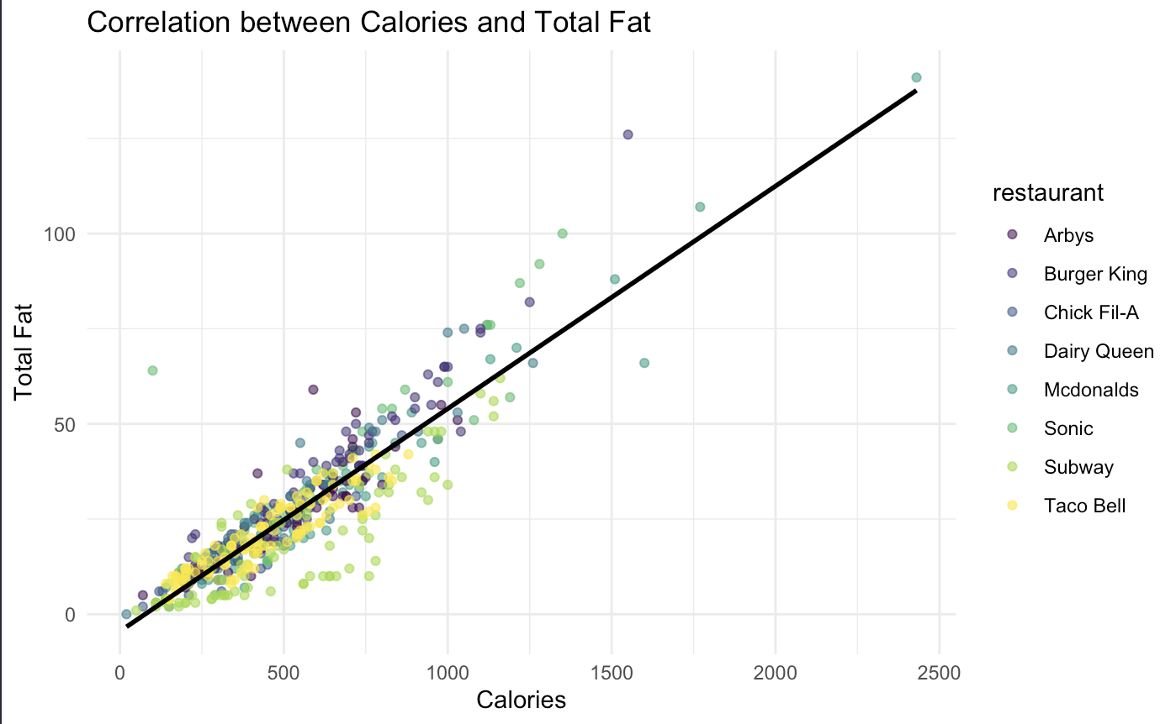
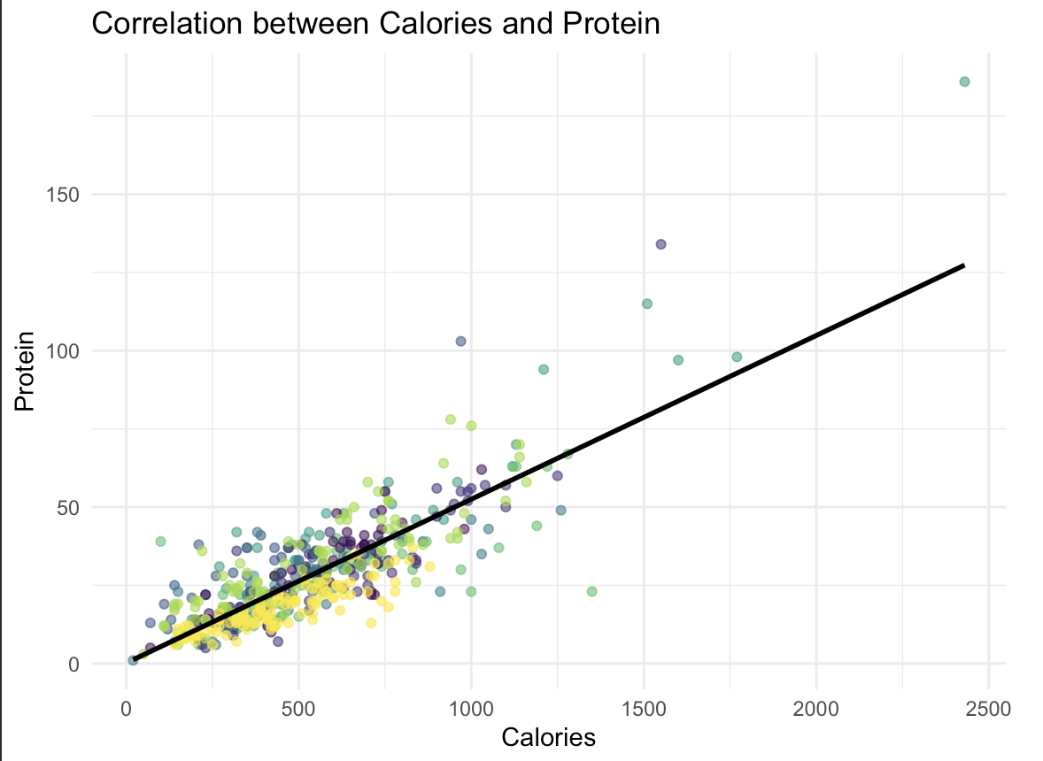
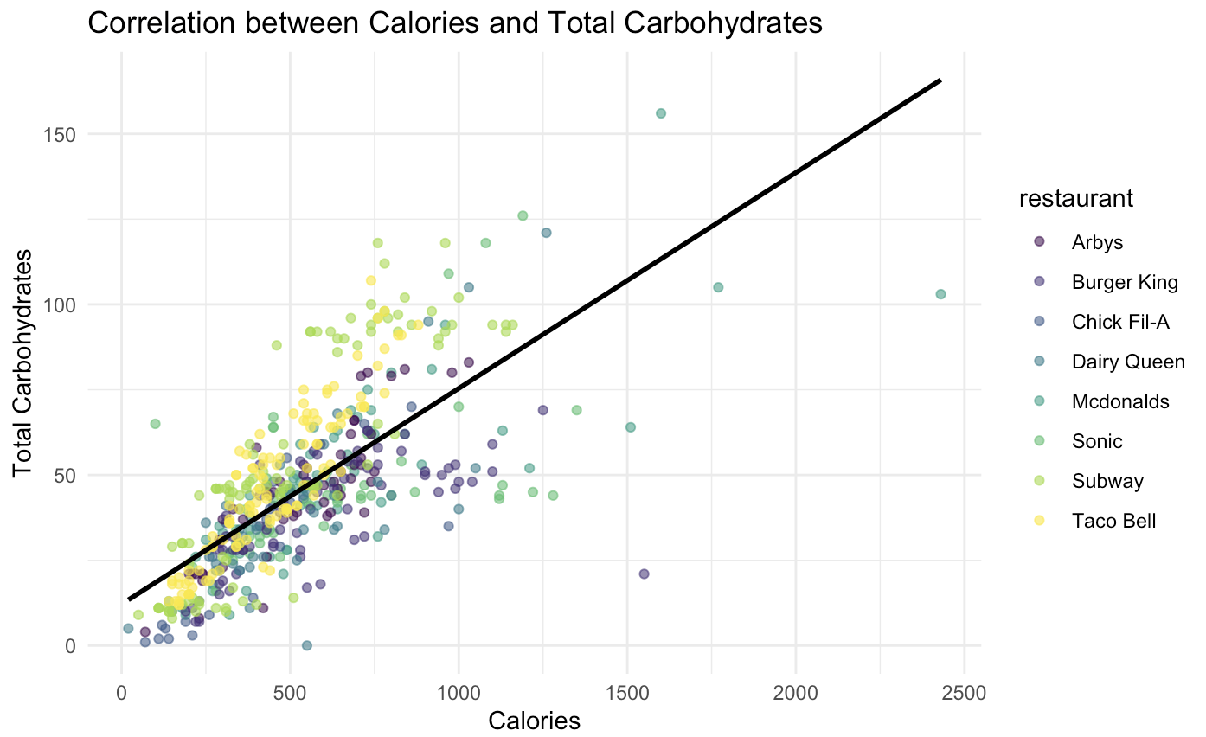
Correlations!
Calories vs. total Fat? Calories vs. Protein? Calories vs. Carbohydrates
0.8992933
0.8319566
0.7140314

Slide 13
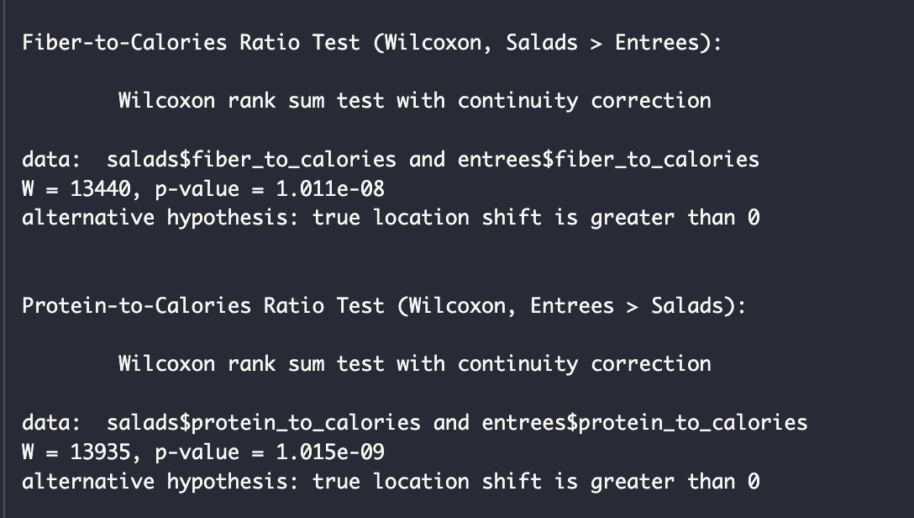
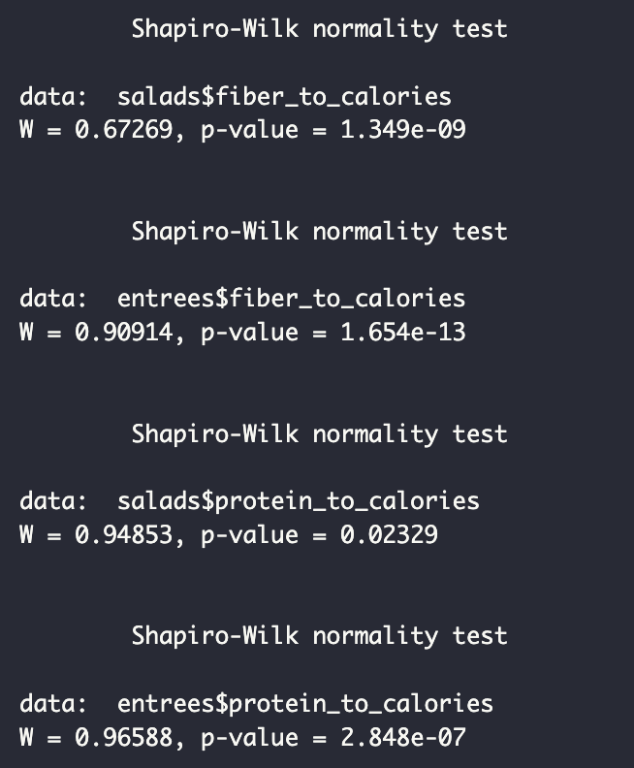
Entrees vs. Salad
Does Salad contain more fiber and protein than entrees?
Fiber to Calories
Protein to Calories
Not normally Distributed
Wilcoxon test!
Salad contains more fiber and protein than entrees!

Slide 14
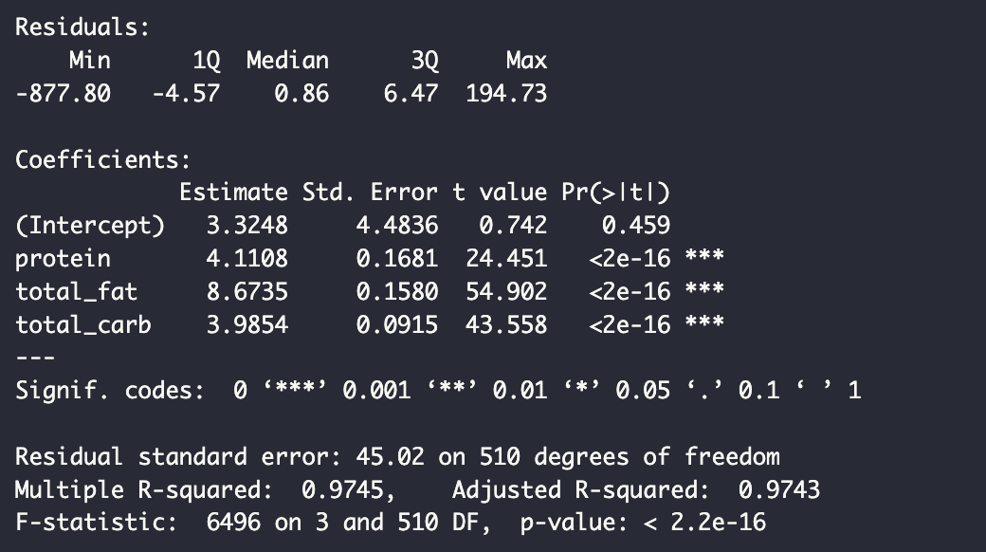
Linear Regression!
Based on our correlation, we want to see
Can we use protein, fat, and carb levels to predict calories? calories ~ protein + total_fat + total_carb ?
R-square = 0.9745 → close to 1
Residual standard error : 45.02 → there might be around 45 calories of oscillation/error in our predicted results
Calories = 3.3248 + 4.1108* Protein + 8.6735 *Total Fat + 3.9854 *Total Carbohydrates

Slide 15
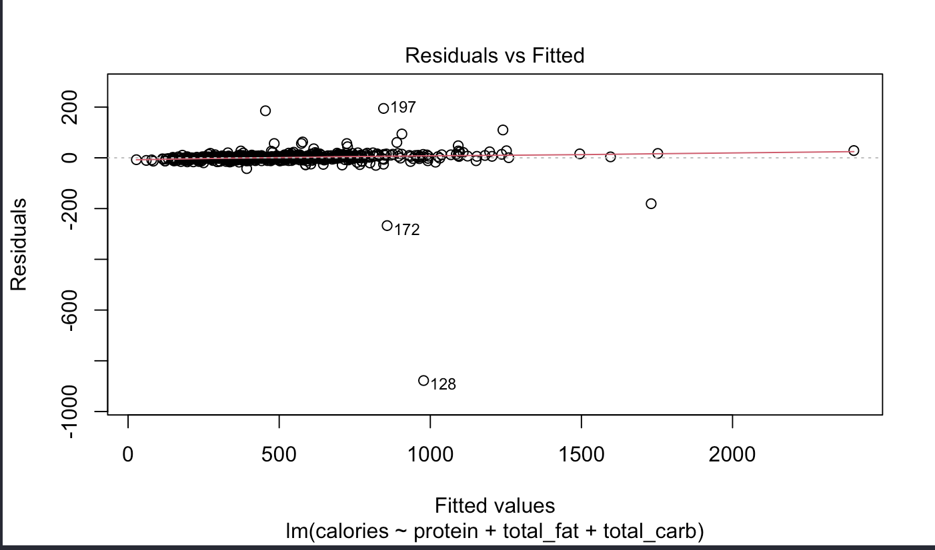
Fitted Plot!

Slide 16
Thank you!

Slide 17




Pet Classifier Tonnar Castellano

Slide 18

Motivation
What is that dog?
What kind of dog do I own?
Is it a cat?

Slide 19

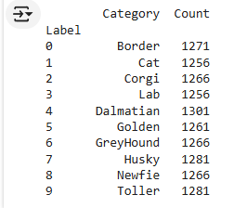
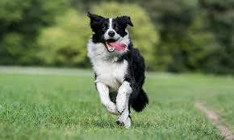
Dataset

Slide 20
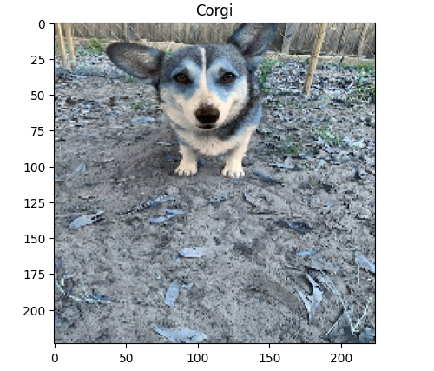
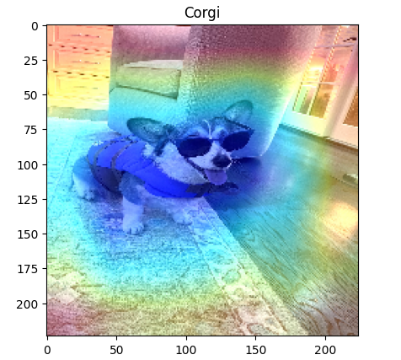
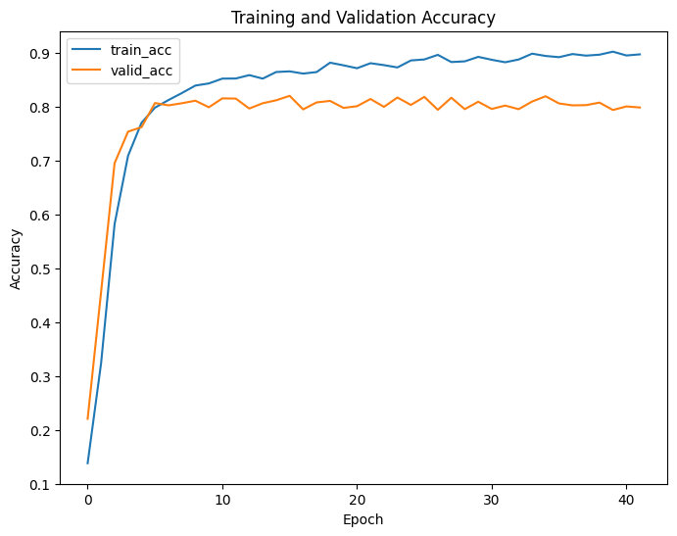
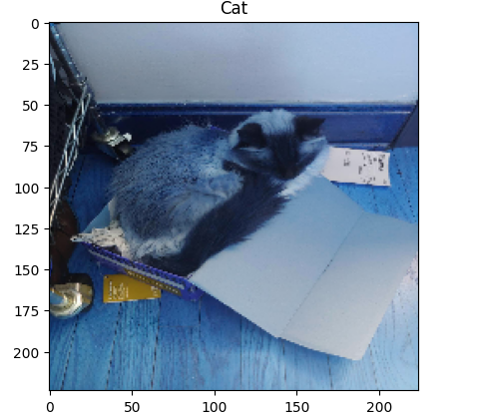
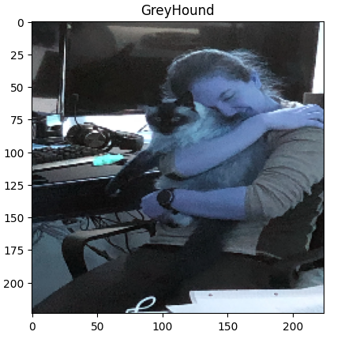
Results

Slide 21
Tightening the Standards: Decades of Ozone Compliance Trends
Data Analysis Project
Aleksya Drobshoff

Slide 22
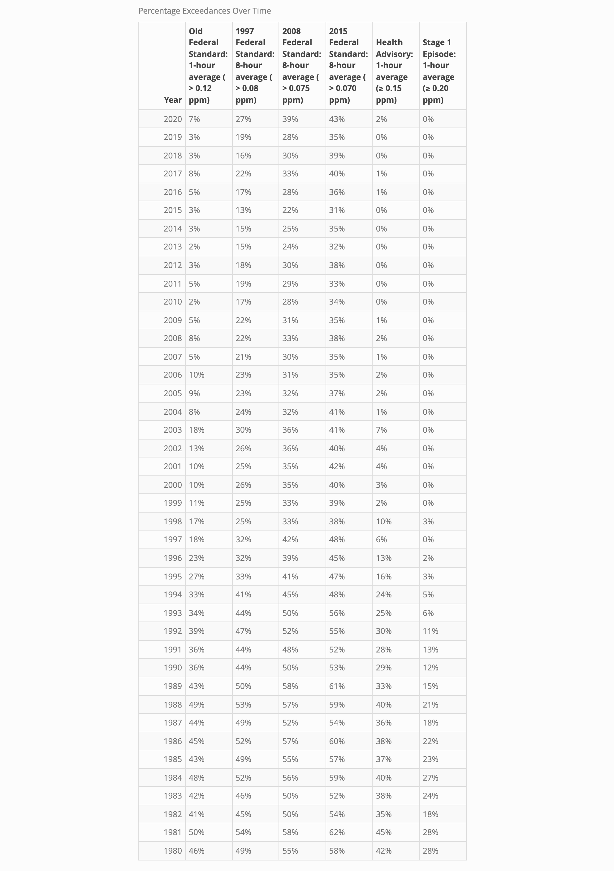

Insights into Ozone Trends: Statistical and Percentage Analysis

Slide 23
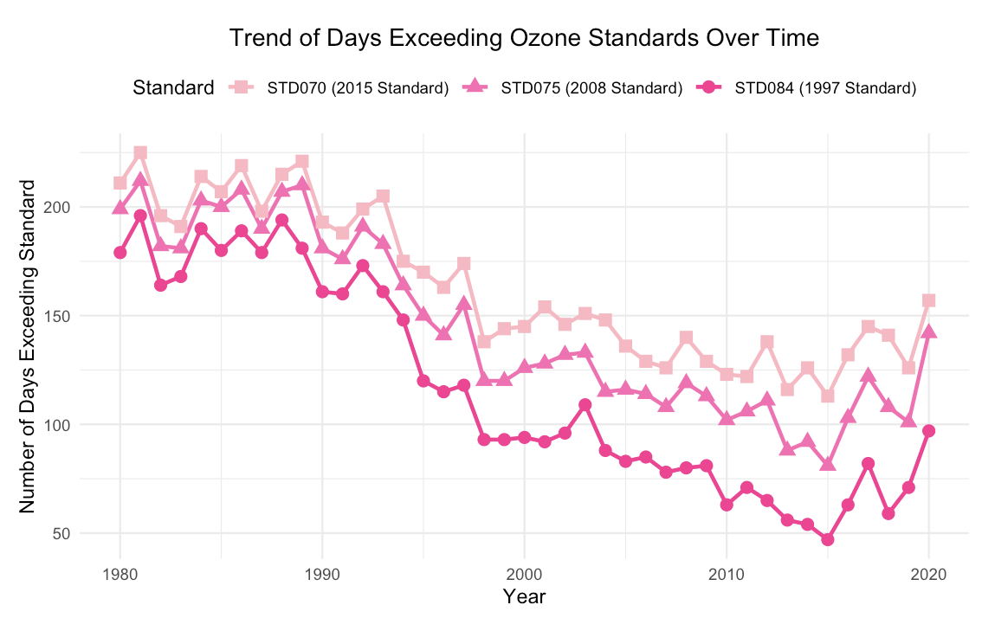
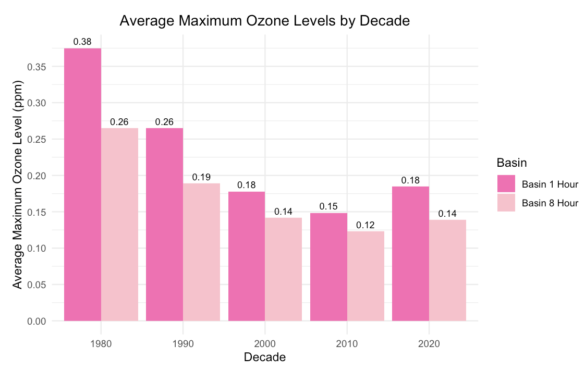
Ozone Trends: Standards Over Time and Basin-Level Comparisons

Slide 24
Microplastics in the Thames River
Ethan Durham

Slide 25

Microplastics in the Thames River

Slide 26
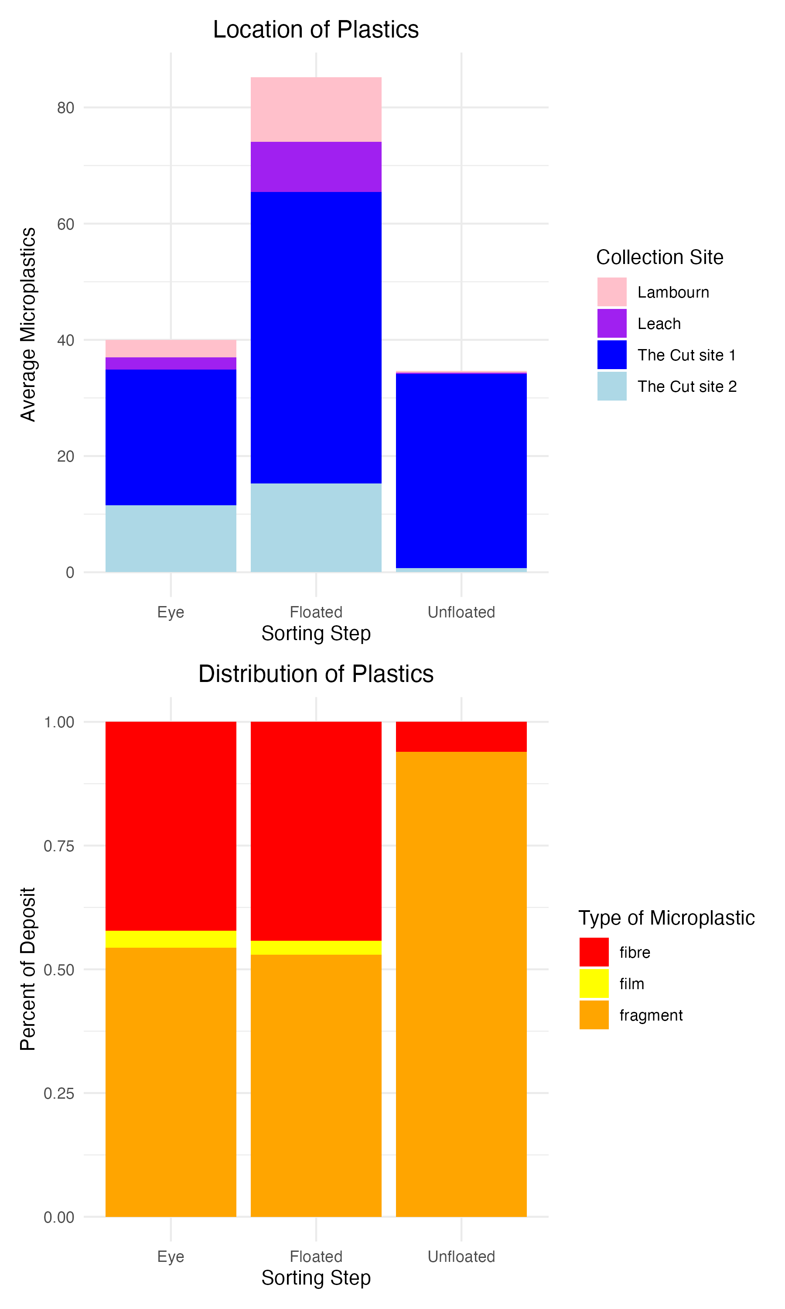
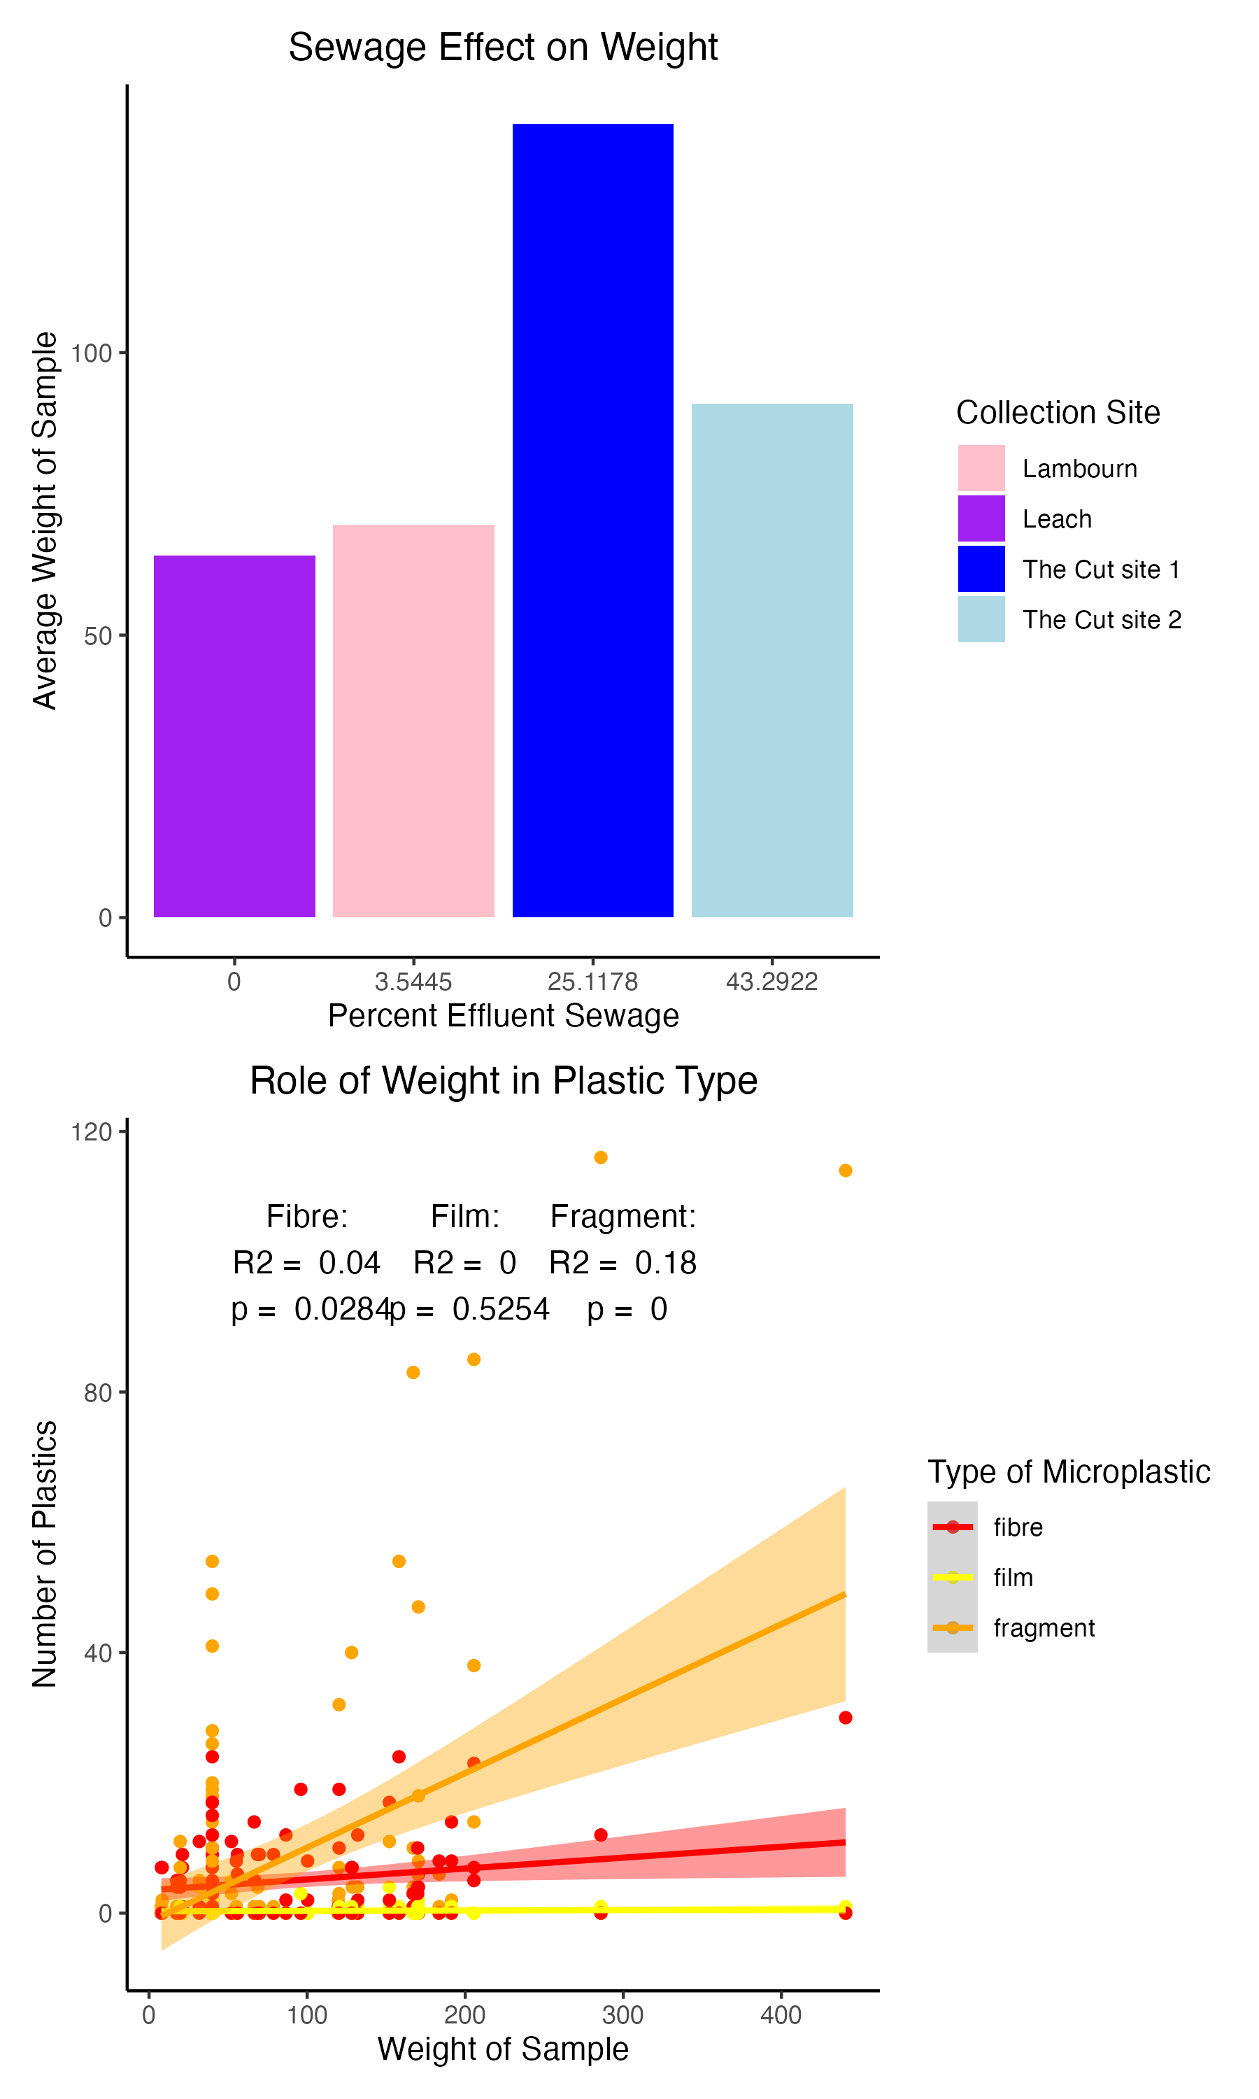
Percent Effluent: amount of sewage that is made up of waste
Population Density: Based on population served by waste treatment plant

Slide 27
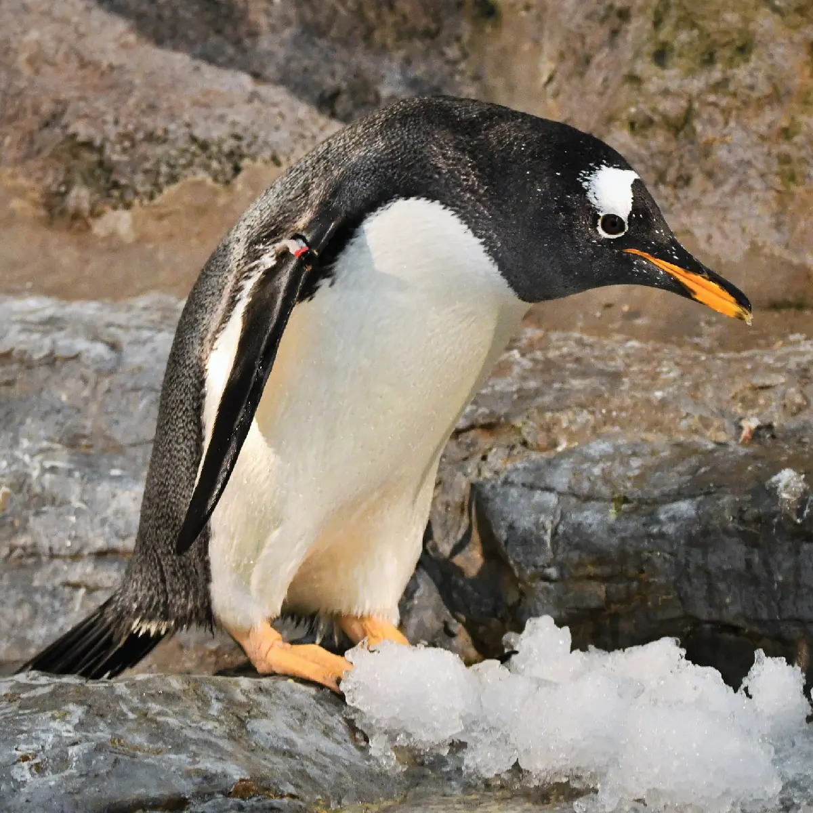
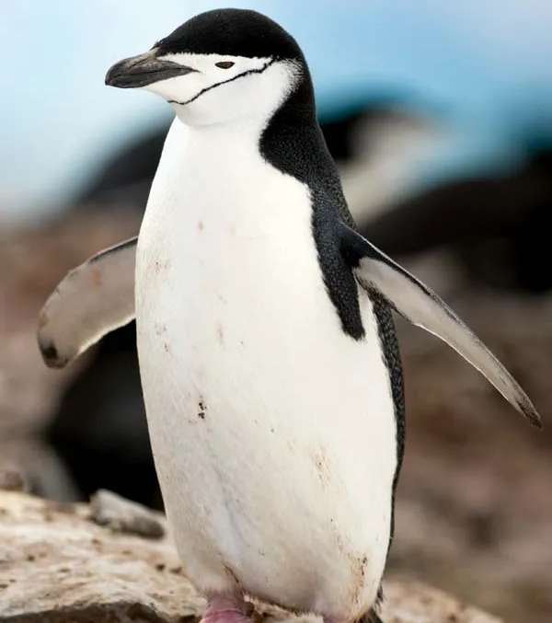

Palmer Archipelago Penguins
James Evans
Notes:
Left to right: Chinstrap, Gentoo, Adelie

Slide 28
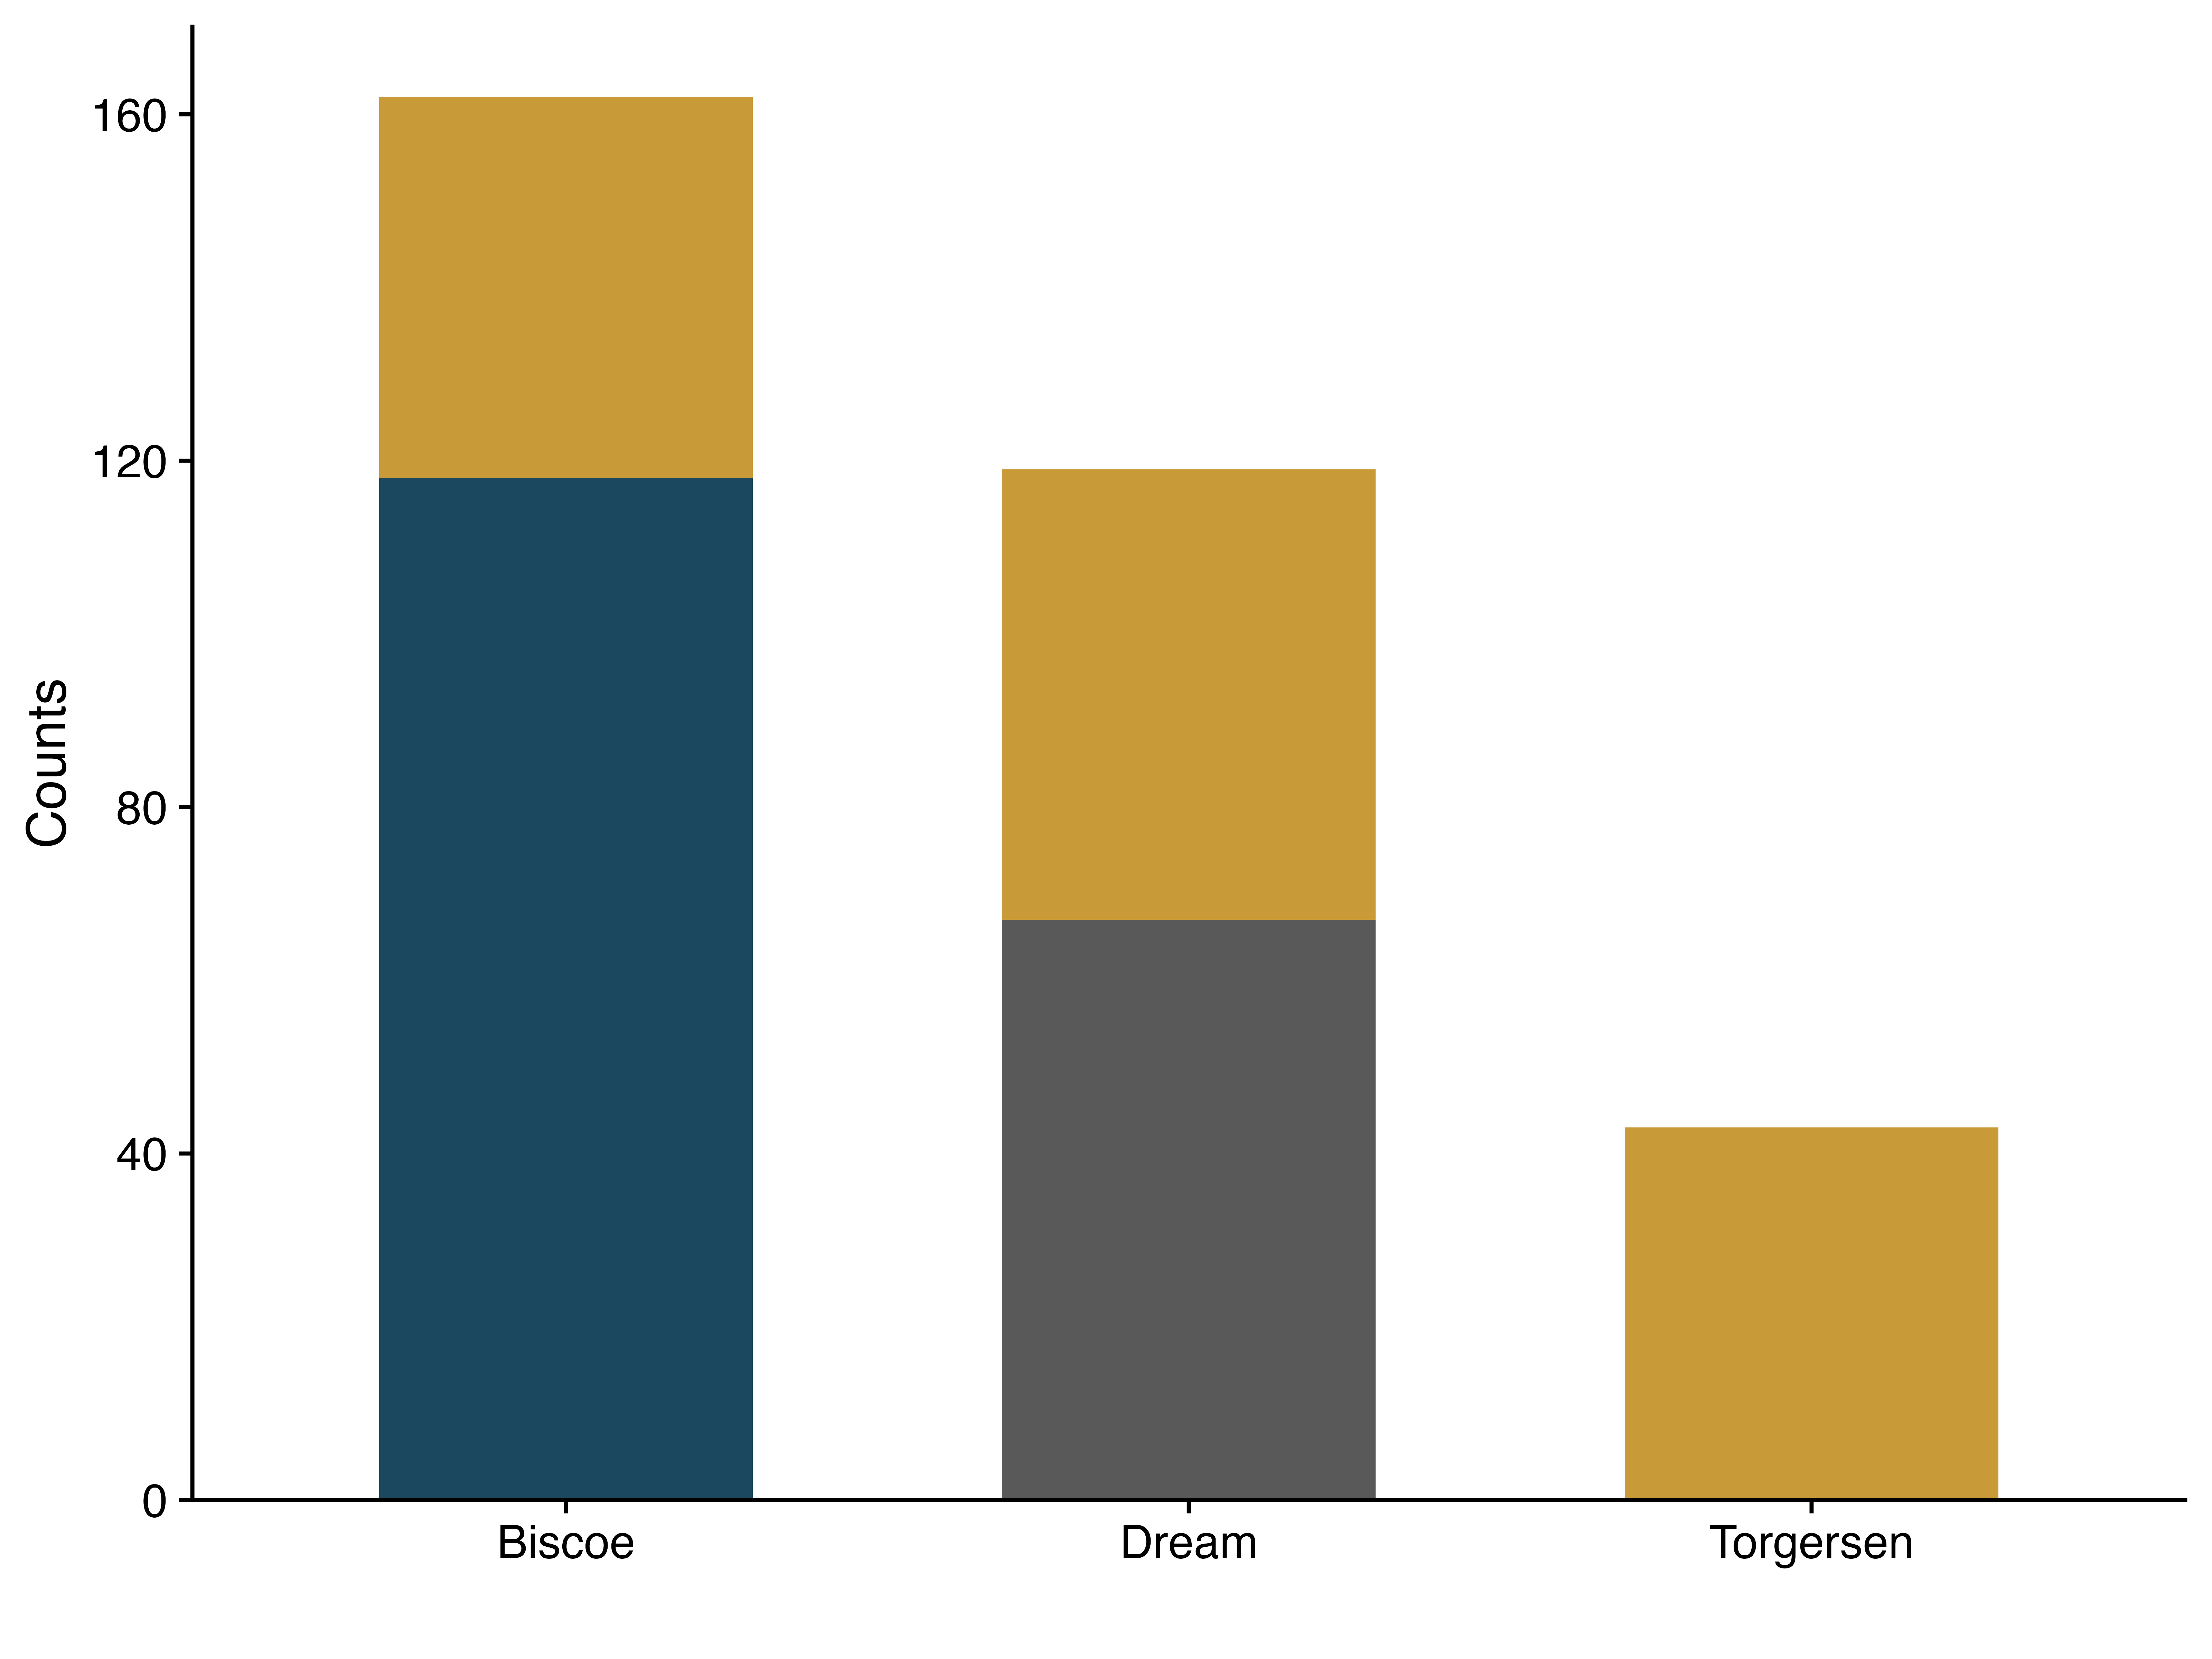
Penguin Species Distribution

Slide 29
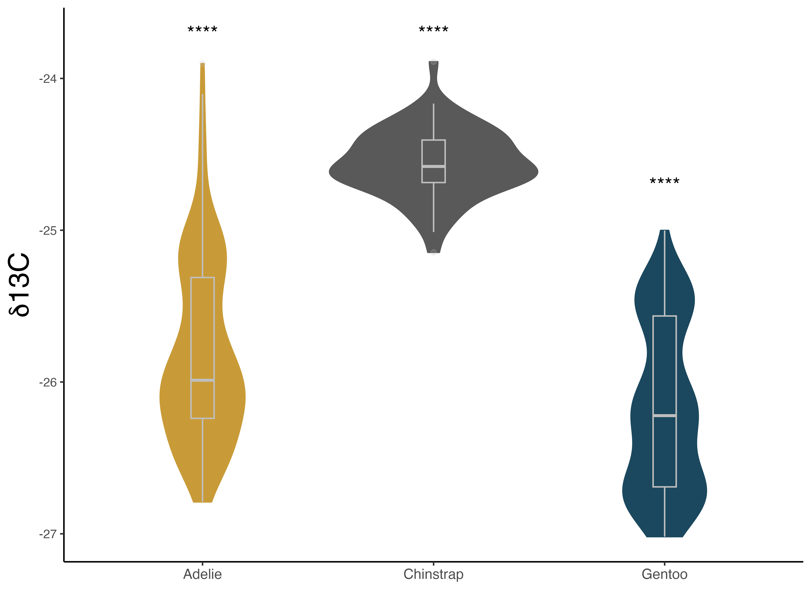
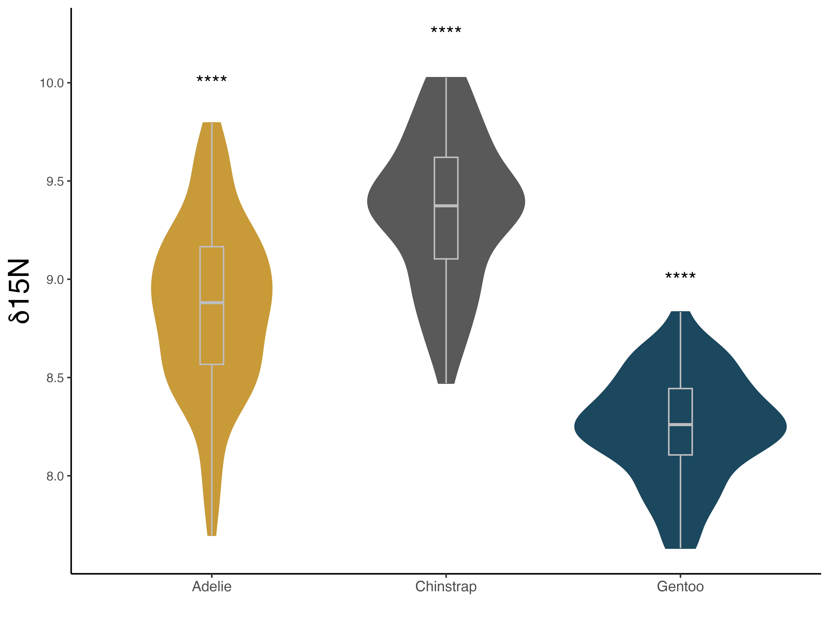

Slide 30
Factors that Impact Student Performance on Exams
Factors that Impact Student Performance on Exams
Katie Jo Gelasco
Notes:
Insert demographic table explaining basic n numbers

Slide 31
Factors that Impact Student Performance on Exams
This dataset contains the exam scores of 6378 students and their performance on the same exam
It also contains other demographic details like gender, extracurricular involvement, parental education level, education type, etc.
Notes:
Insert demographic table explaining basic n numbers

Slide 32
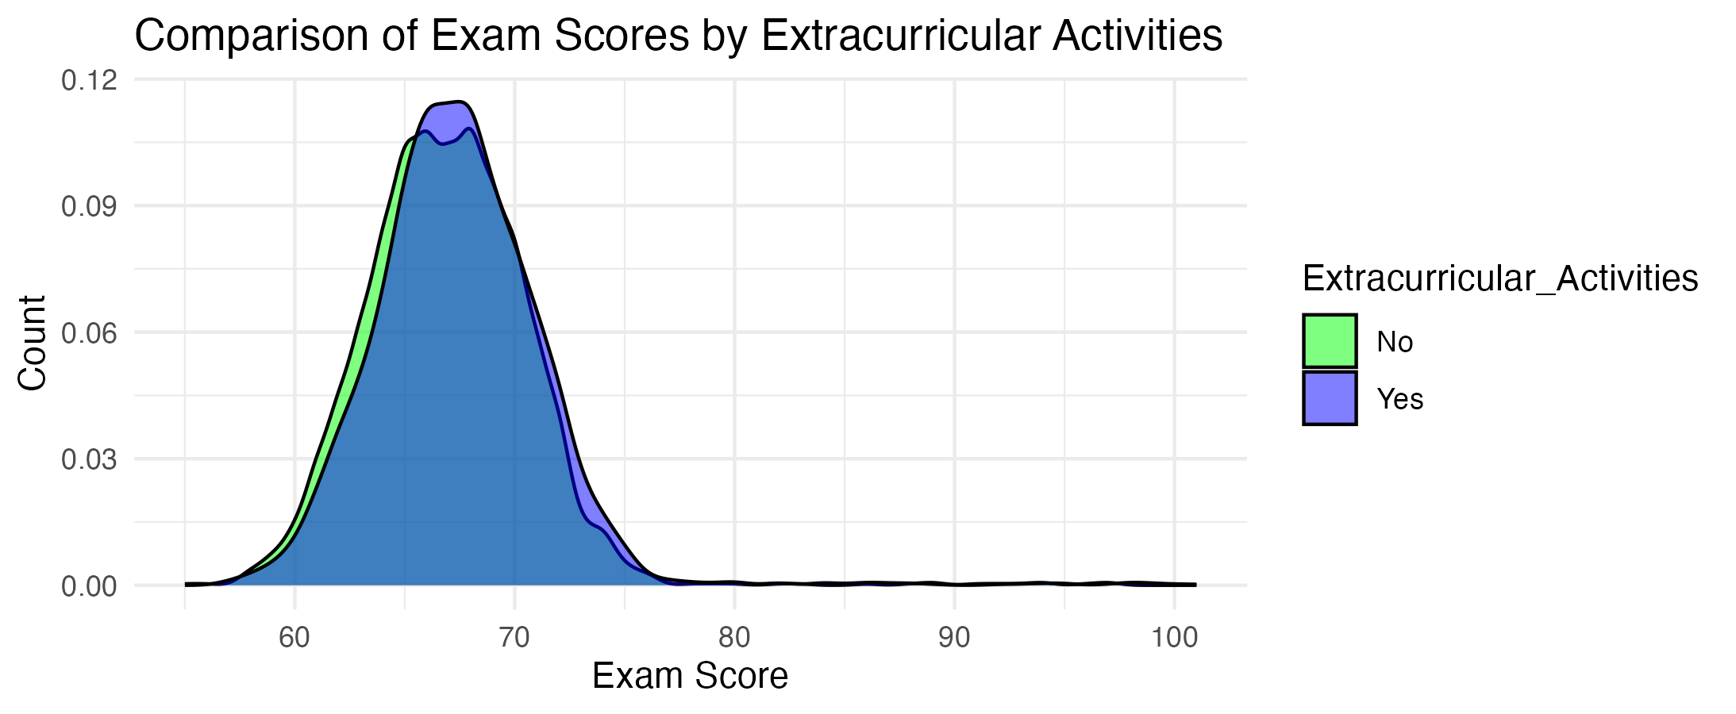
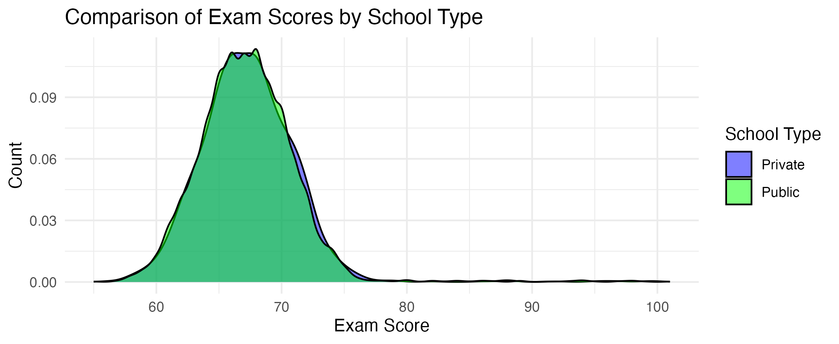
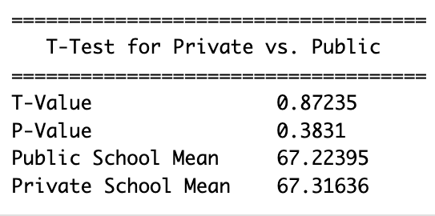
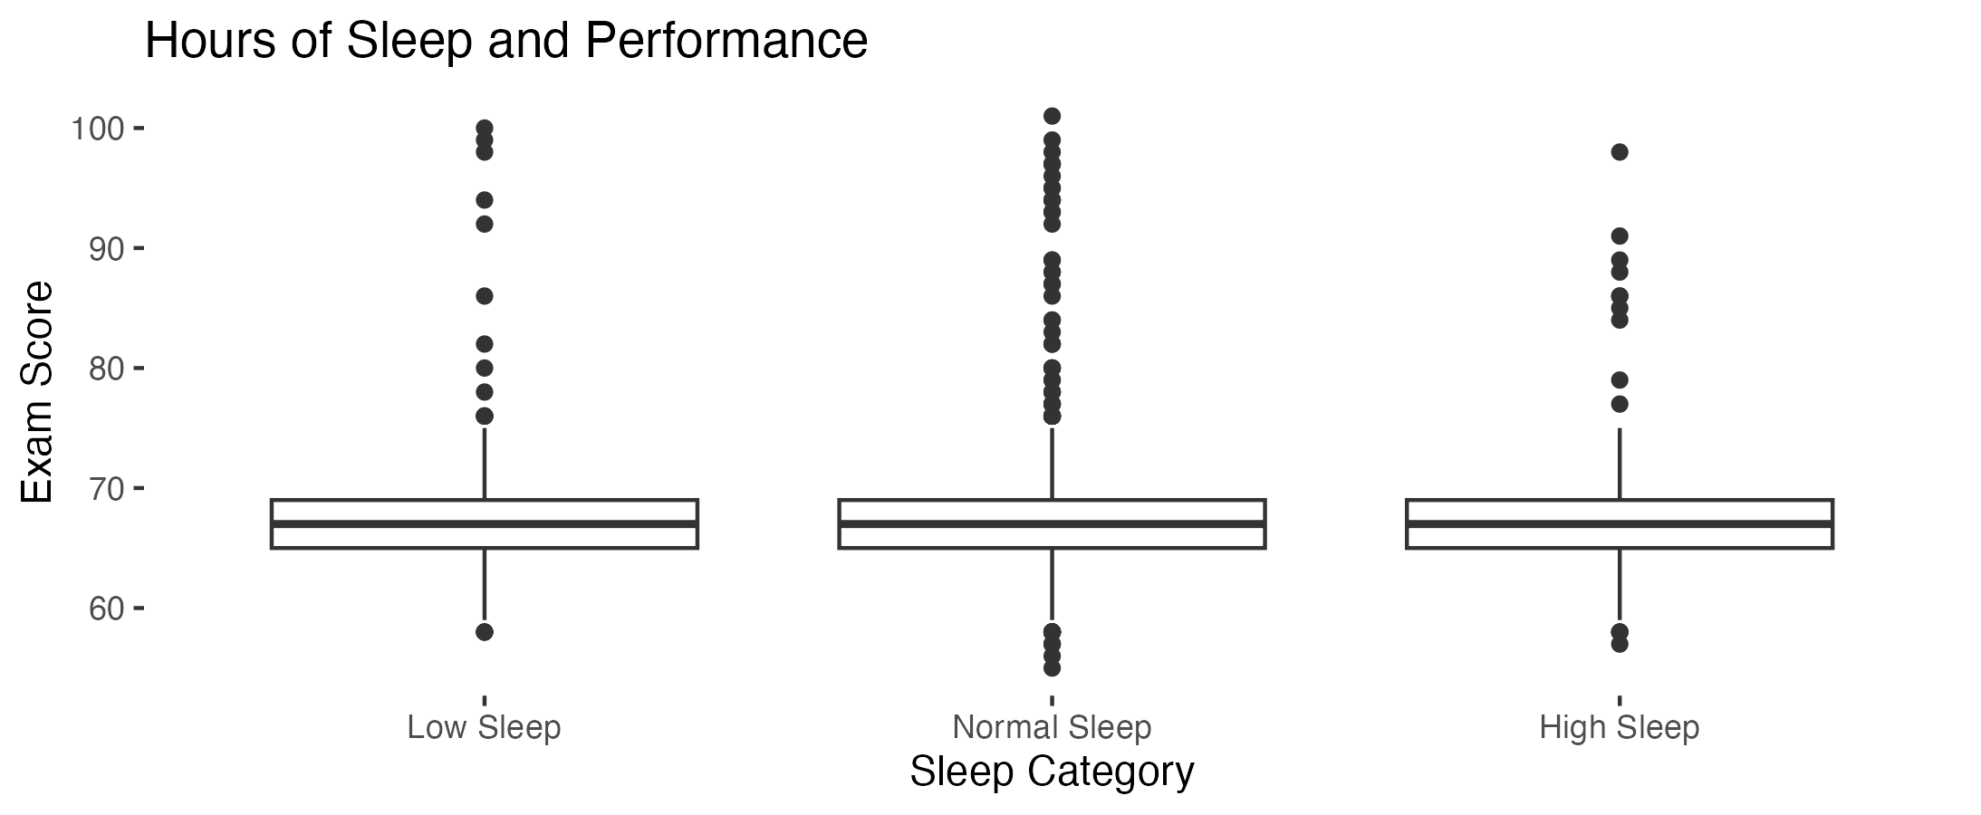
Factors that did not affect exam performance
-School Type
-Extracurricular Involvement
-Sleep
Notes:
Insert t-test; box plot; density plots

Slide 33
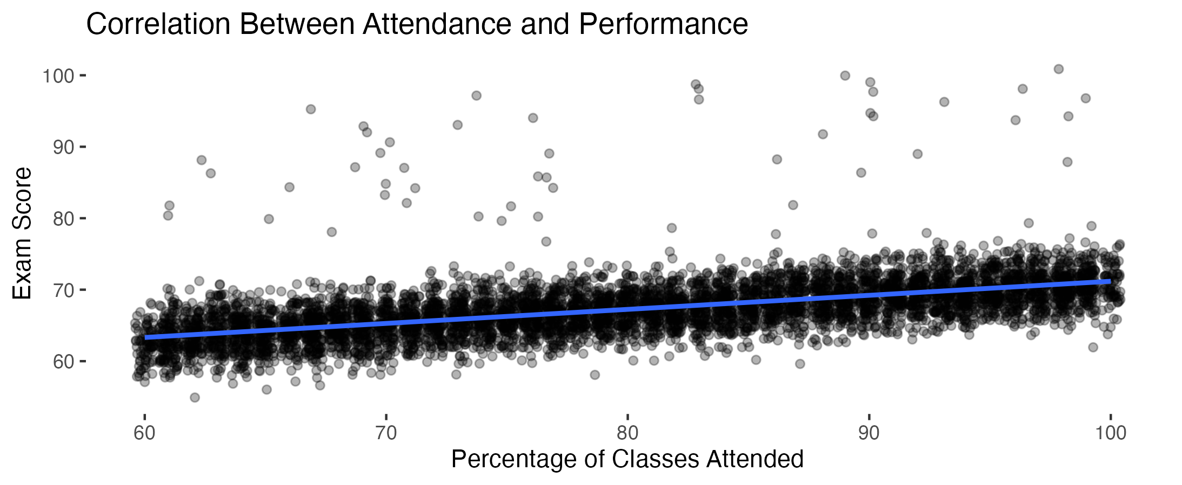
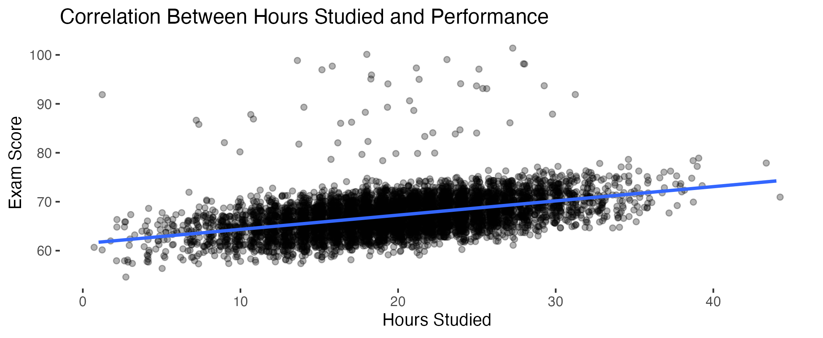
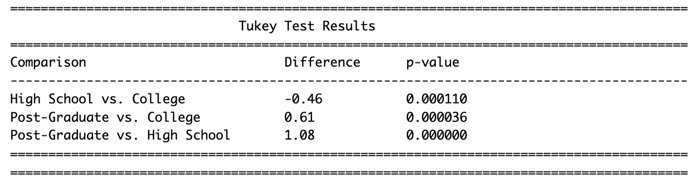
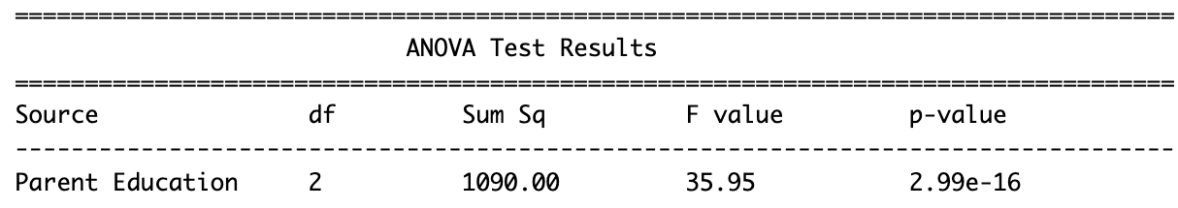
Factors that did affect exam performance
-Attendance
-Study time
-Level of parental education
Notes:
Insert ANOVA test and table, and correlation plots

Slide 34
Impact of demographics on employment sector and stress
Porcia Haynes

Slide 35
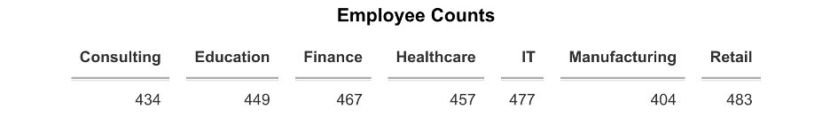
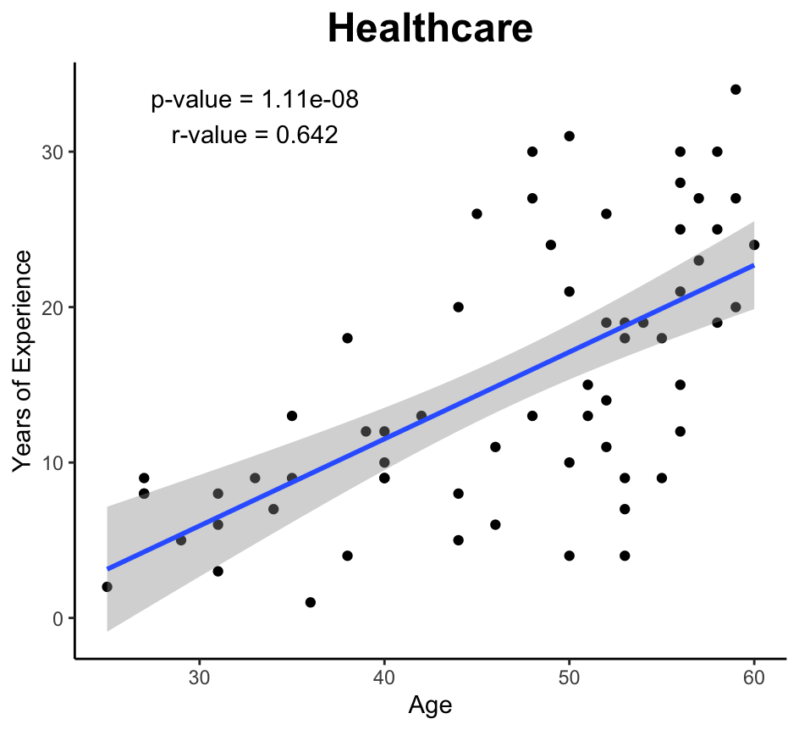
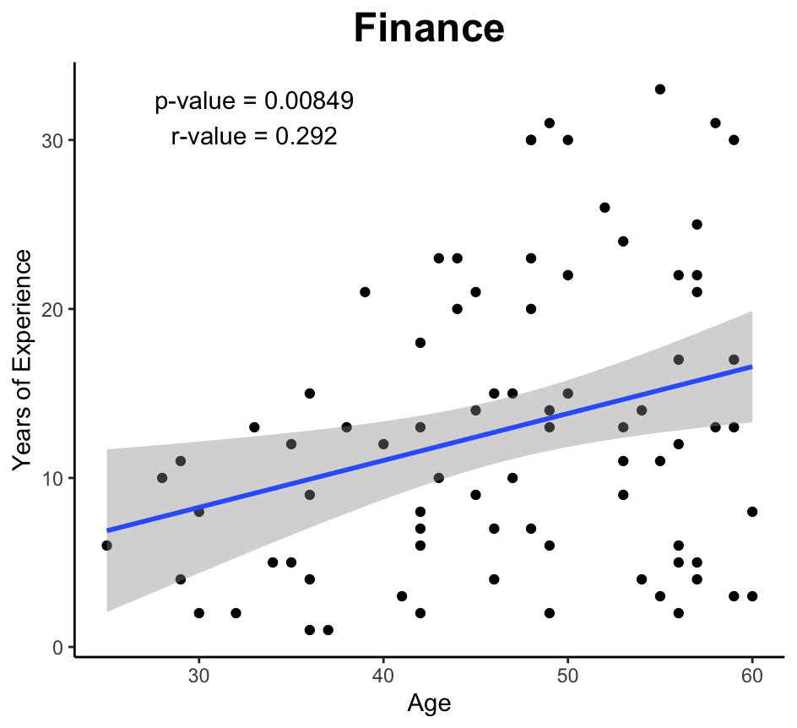

Slide 36
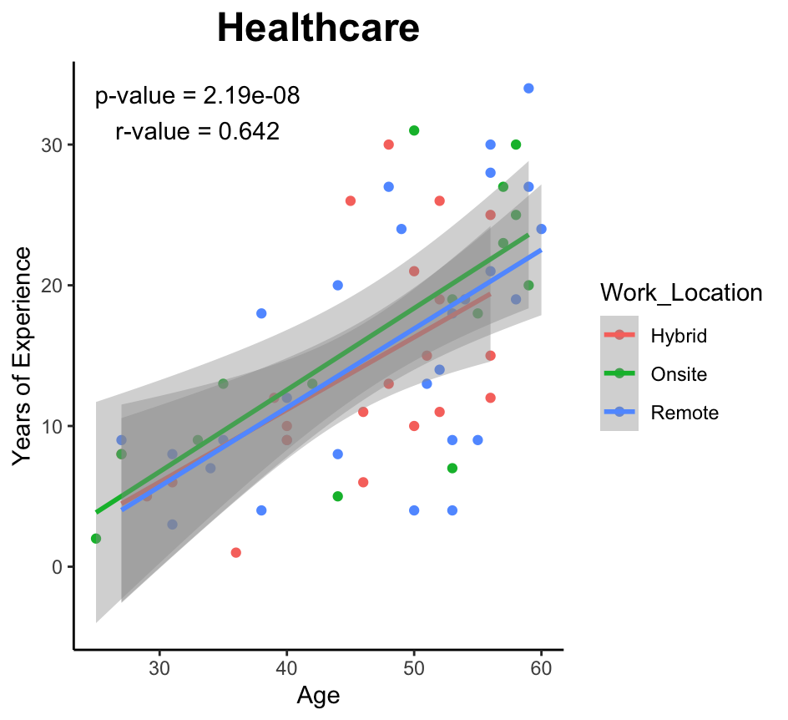
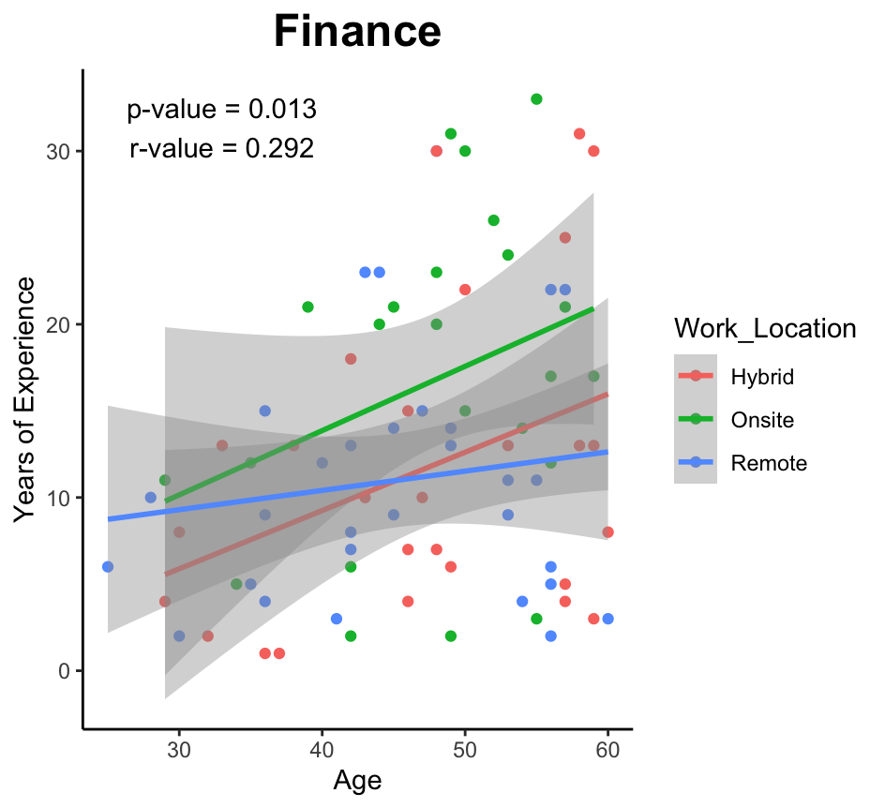
Work Location as a Covariate

Slide 37
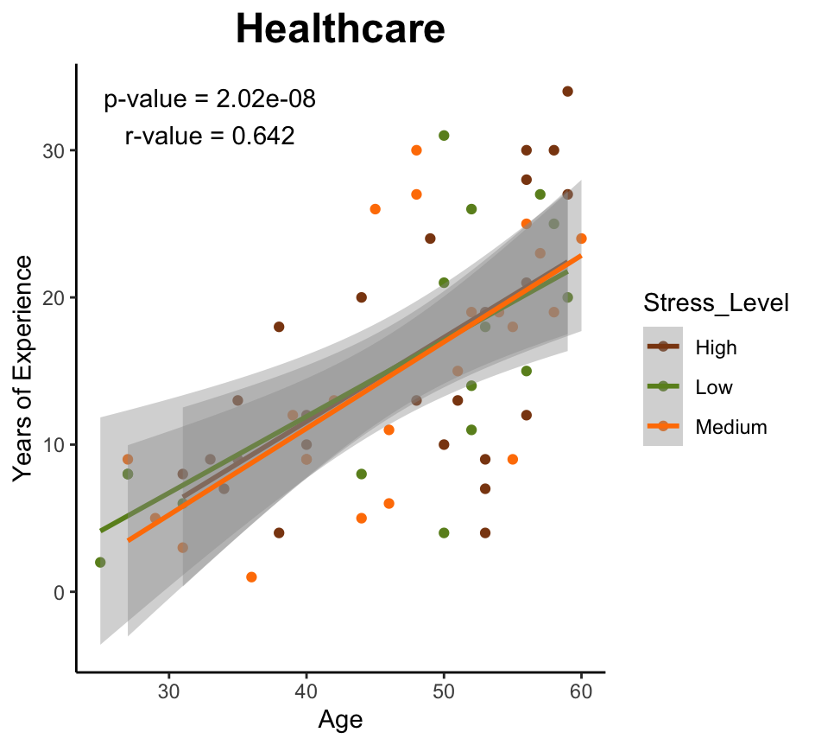
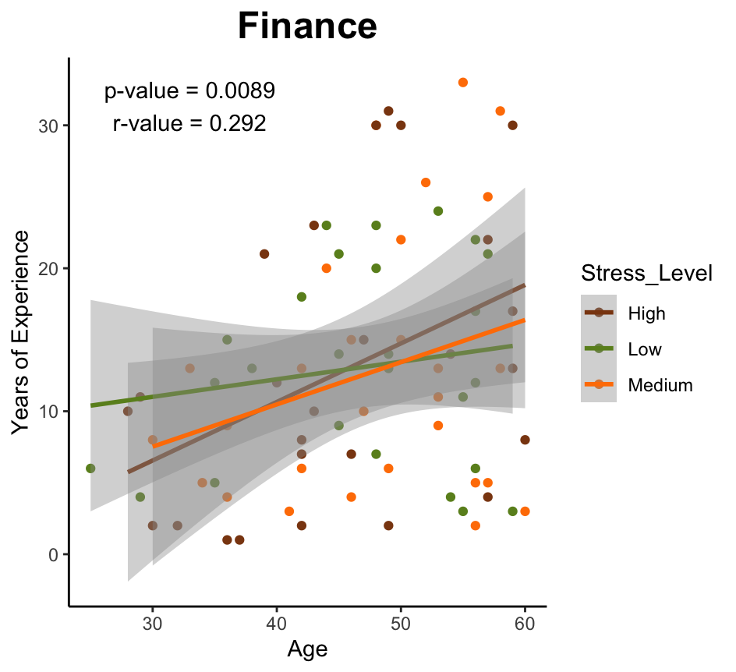
Stress Level as a Covariate

Slide 47
Analysis of Ligation Binding Sequences for two RNAseq Probe sets
Morad Malek

Slide 48
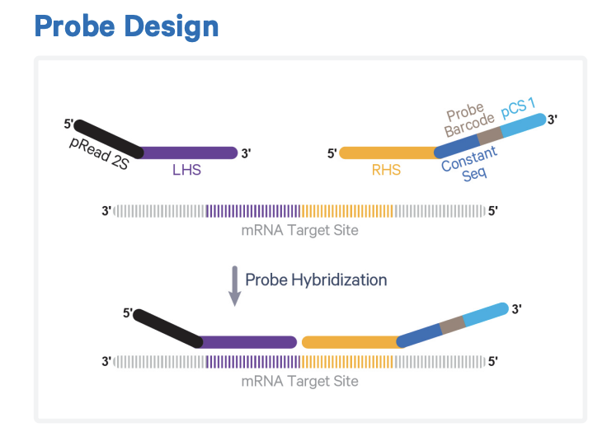
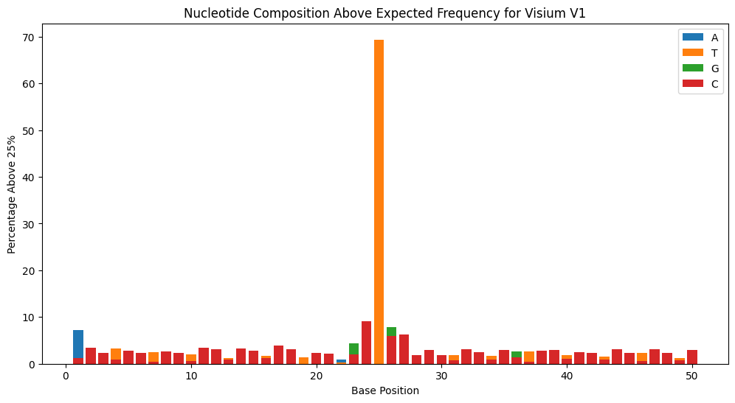
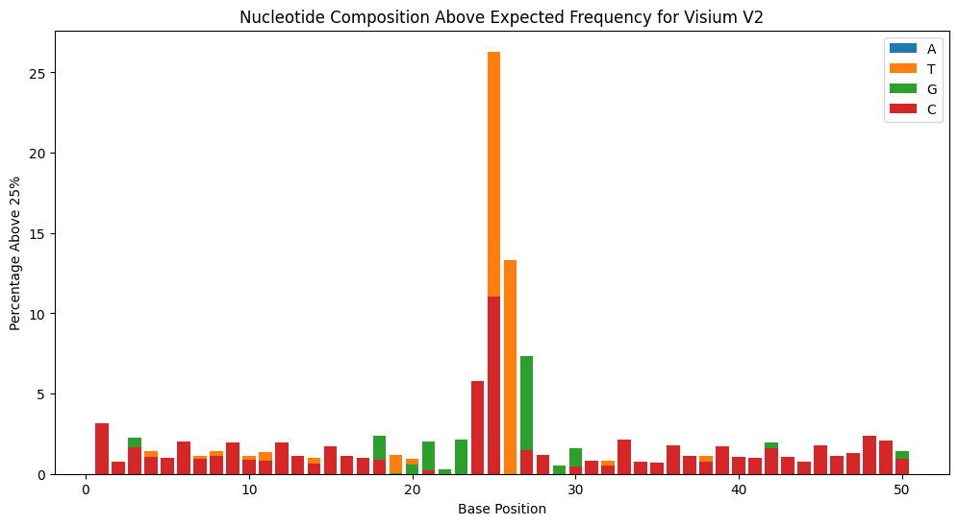
Analysis of Ligation Binding Sequences for two RNAseq Probe sets
Ligase
25nt
25nt
Type?
Preference?
Probe Hybridization
p < 0.001: ***
p < 0.001: ***

Slide 49
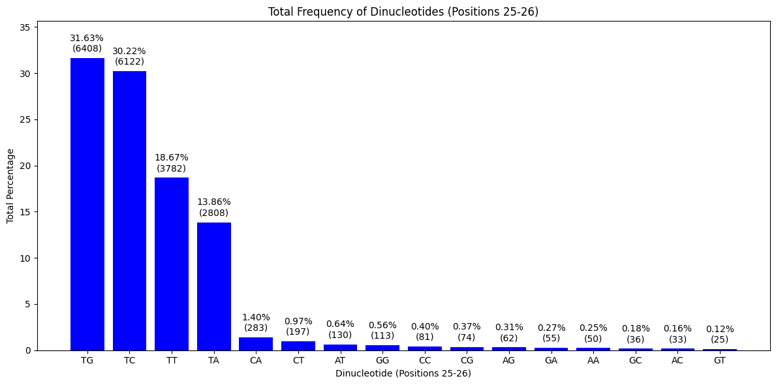
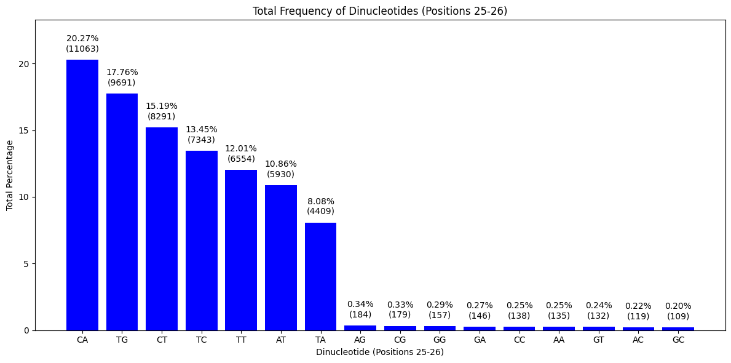

Ligation Binding Sequences V1 vs V2
V1 | V2
TG | TG
TC | TC
TT | TT
TA | TA
- | CA
- | CT
- | AT
p < 0.001: ***
p < 0.01: **
p < 0.05: *

Slide 50

Preliminary Neural Cell Type Targeting for Small Molecule Screening
By: Kole Martin
https://pubmed.ncbi.nlm.nih.gov/38729112/
https://www.nih.gov/news-events/news-releases/researchers-fully-map-neural-connections-fruit-fly-brain

Slide 51

Large scale investigation of cell type confidence values to detect preferential bind for neurotransmitters before analysis

Slide 52

Cell type distribution of various neurotransmitters through analysis of both Full Adult Fly Brain (FAFB) and the Hemibrain

Slide 53

Large scale investigation of cell type confidence values to detect preferential bind for neurotransmitters after analysis

Slide 54

Top 10 cell types with the highest acetylcholine confidence sum

Slide 55
Relationship between sleep habits and physical activity level
Jessica Myat

Slide 56





Relationship between sleep habits and physical activity level

Slide 57
Predicting Diabetes Outcome using Health Metrics from the Pima Indians Diabetes Dataset
Paige Pfotenhauer

Slide 58
Pima Indians Diabetes Dataset
Health metrics:
Age
Diabetes Pedigree Function (DPF)
Body Mass Index (BMI)
Insulin
Triceps skin thickness
Blood pressure
Plasma glucose levels
Number of pregnancies
Dataset characteristics:
768 Pima women
> age 21
Health metrics
Diabetes outcome
Diabetes outcome
(binary, 0 or 1)

Slide 59

Model Development
Binary logistic regression models:
1. Single Predictor (Glucose)
2. Key Variables (Glucose + Body Mass Index)
3. Full (All variables)

Slide 60


Logistic Regression Model Outcome

Slide 61
Data Analysis Project
Ellie Pingry

Slide 62



Background
Data base used: The Molecular Taxonomy of Breast Cancer International Consortium (METABRIC) database
Age at diagnosis factors vs. Overall survival months:

Slide 63




Slide 64
Analysis of Mental Health and Technology Usage (Kaggle Dataset)
Alexis Roberson
CPBP 8000
5 Dec 2024

Slide 65





Slide 66




Slide 67
WORKOUT STUDIES
Salimat Sofela

Slide 68

Plot of Fat Percentage against Calories Burned
There is negative correlation between fat
percentage and Calories burned. That is,
the higher the calories burned, the lesser
the amount of fat in the body.

Slide 69

Weight Vs Gender
This is a t- test of the distribution of weight between the male and female gender that goes to the gym. The weight of male gender is significantly higher than the female.

Slide 70

Plot of Fat Percentage against Workout Frequency
Anova analysis of the effect of the fat percentage in male and female relative to the amount of days in a week dedicated to working out . The result shows that fat percentage reduces as workout frequency increases. A stronger effect is seen when you spend more than 3 days in a week.

Slide 71

Plot of Fat Percentage against Experience Level
Anova analysis of the effect of the fat percentage in male and female relative to the experience level of the individual. The result shows that there is significant decrease in fat percentage in gym members with more experience on how to perform exercises.

Slide 72

Effect of Workout in different Workout Types
A greater result is seen in members that perform the HIIT (High-Intensity Interval Training) type of exercise. We can therefore conclude that HIIT helps burn more calories and boost metabolism better compared to the other types of exercises.
Also, no significant differences were observed in heart rate across the different workout types. This suggests that all the exercises studied are effective for maintaining cardiovascular health.

